Slide 1

Deep Learning Final Project
Object Detection of People, Animals, Daleks, and Lightsabers
Robert Stevens
ECEN 5060 - April 30, 2025

Slide 2
Introduction
YOLOv8 model used for multi-class object detection.
Classes: person, dog, cat, dalek, sith lightsaber, other lightsaber.
Includes dataset preparation, training, evaluation, CI/CD.

Slide 3
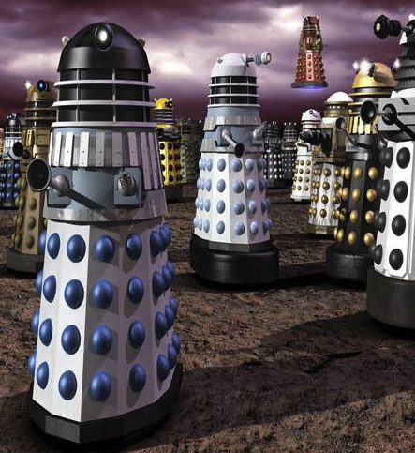
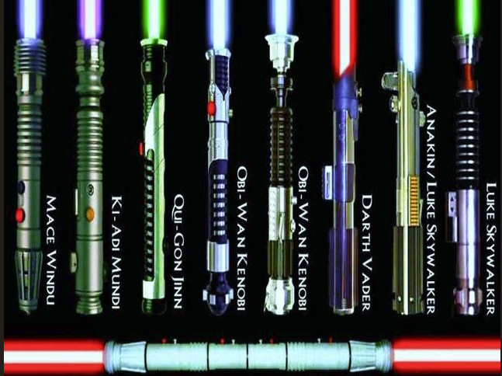
Examples
Daleks:
Lightsabers:

Slide 4
Dataset Overview
Custom and COCO-based data.
YOLO-format annotations.
Balanced structure for train/val/test.

Slide 5
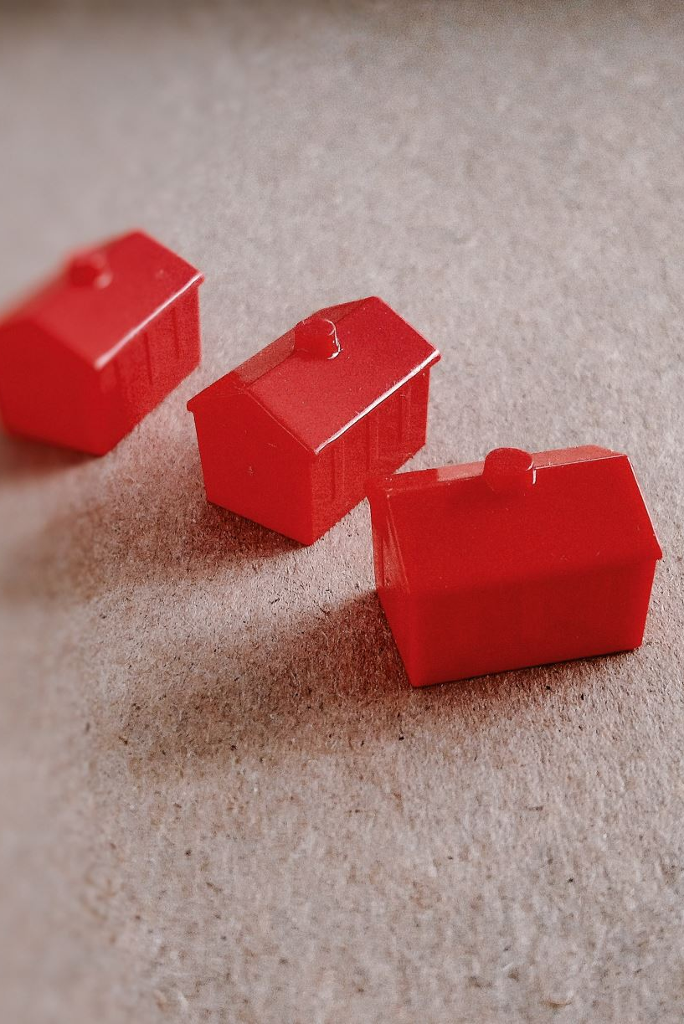
3. Model Architecture
YOLOv8n with FPN + PANet.
Input: 640x640, Loss: DFL + classification + box.
Trained for 50 epochs with SGD.

Slide 6
4. Training Diagnostics
Training and validation loss declined consistently.

Slide 7
5. Evaluation Metrics
Dalek: 82% precision, 91% recall.
Person: 68% precision, 66% recall.
Lightsaber classes: high recall, lower precision.

Slide 8
Code Infrastructure
CI/CD with GitHub Actions.
Dry run checks on training & inference.
Documentation generated with Pydoc.

Slide 9
7. Innovation & Challenges
Real-time video controls (pause, skip, speed).
Conditional label filtering.
Cross-platform file path handling.

Slide 10
8. Conclusion
Strong results for Dalek and person detection.
Pipeline deployable and reproducible.
Future: refine class overlap, deploy to edge devices.

Slide 11

Why 640×640 Image Size?
Reasons for using 640×640 resolution:
Good balance between accuracy and inference speed.
Matches YOLOv8 pretrained COCO weights.
Efficient on RTX 3060 GPU (6GB VRAM).
Sufficient resolution for Daleks and lightsabers.

Slide 12
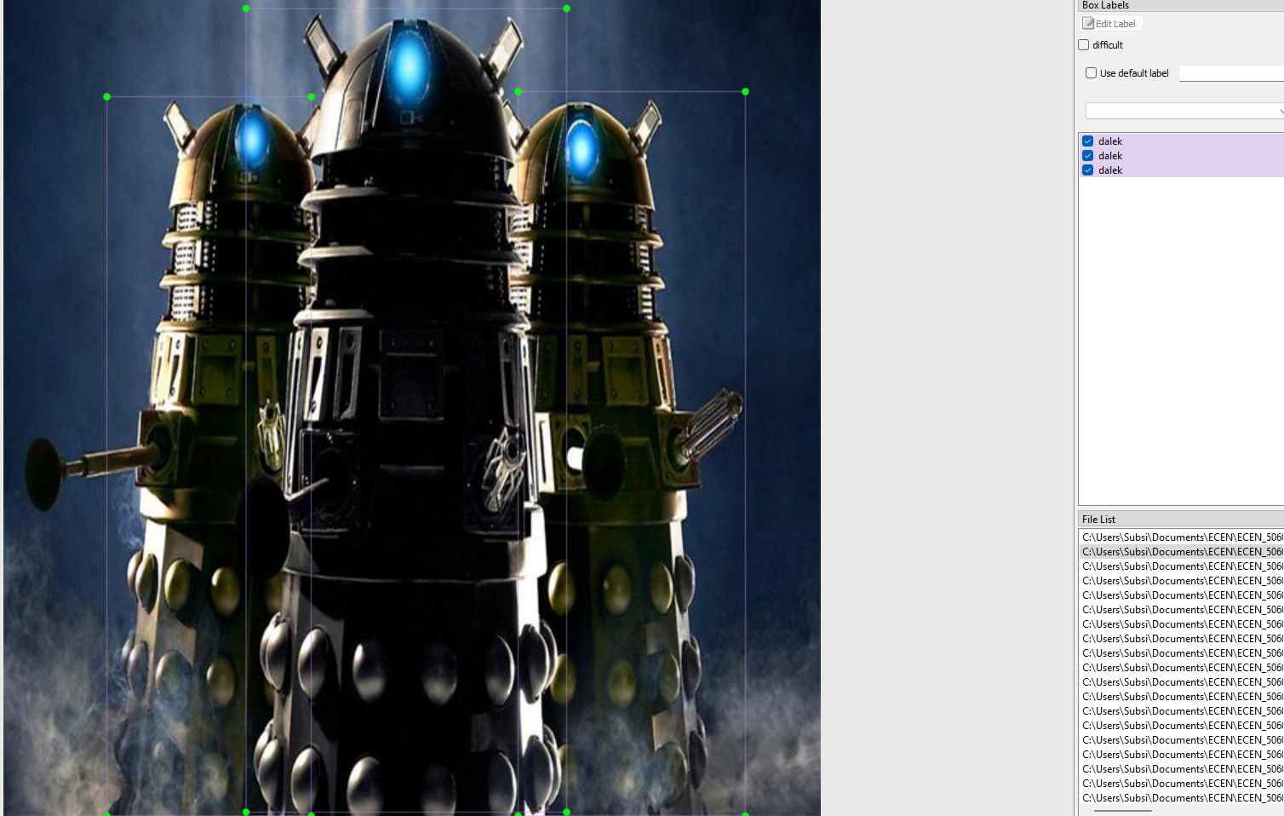
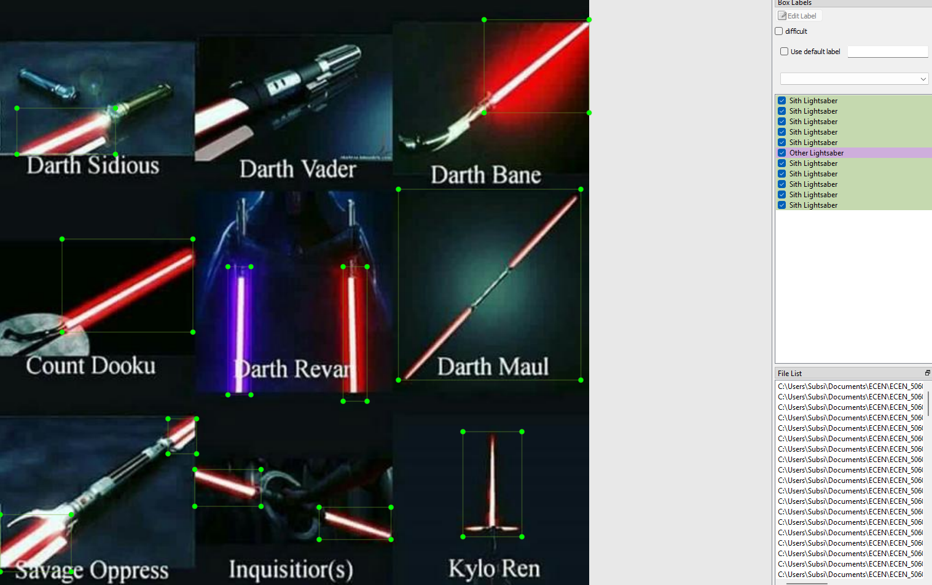
Sample Detection Output
Bounding boxes for Daleks, people, and lightsabers in test video.

Slide 13
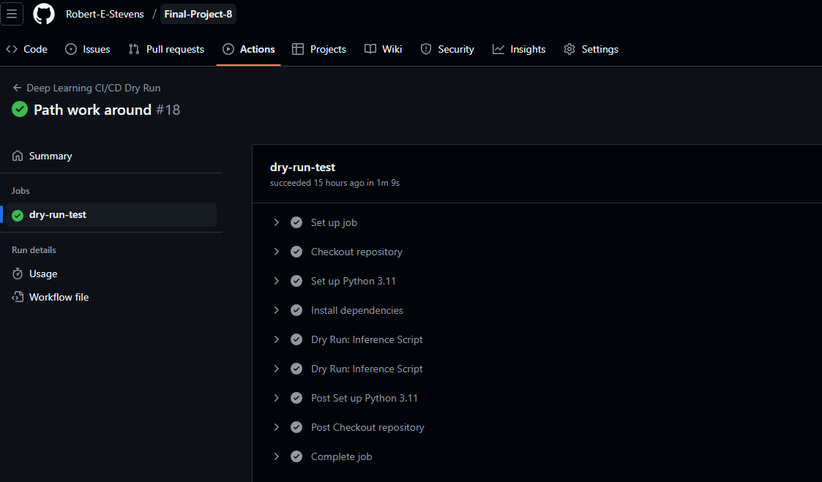
CI/CD Workflow Snapshot
GitHub Actions config for validating training & inference scripts.

Slide 14
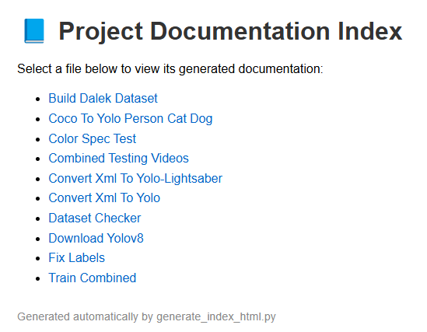
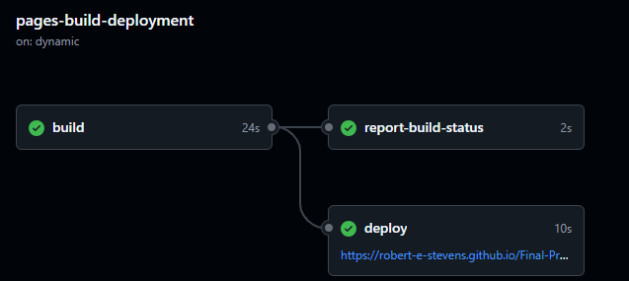
Pydoc
Pydoc for the scripts I used published on github. https://robert-e-stevens.github.io/Final-Project-8/

Slide 15
demo

Slide 16
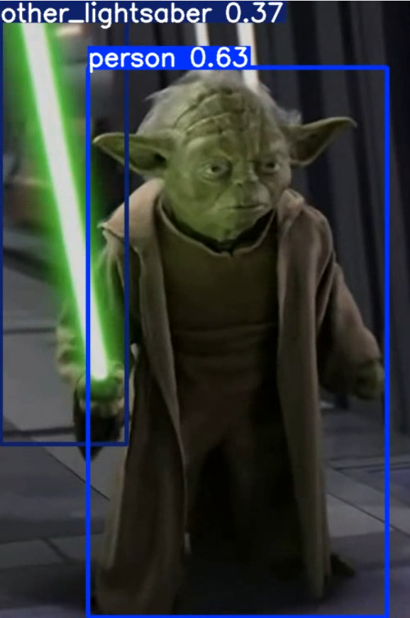
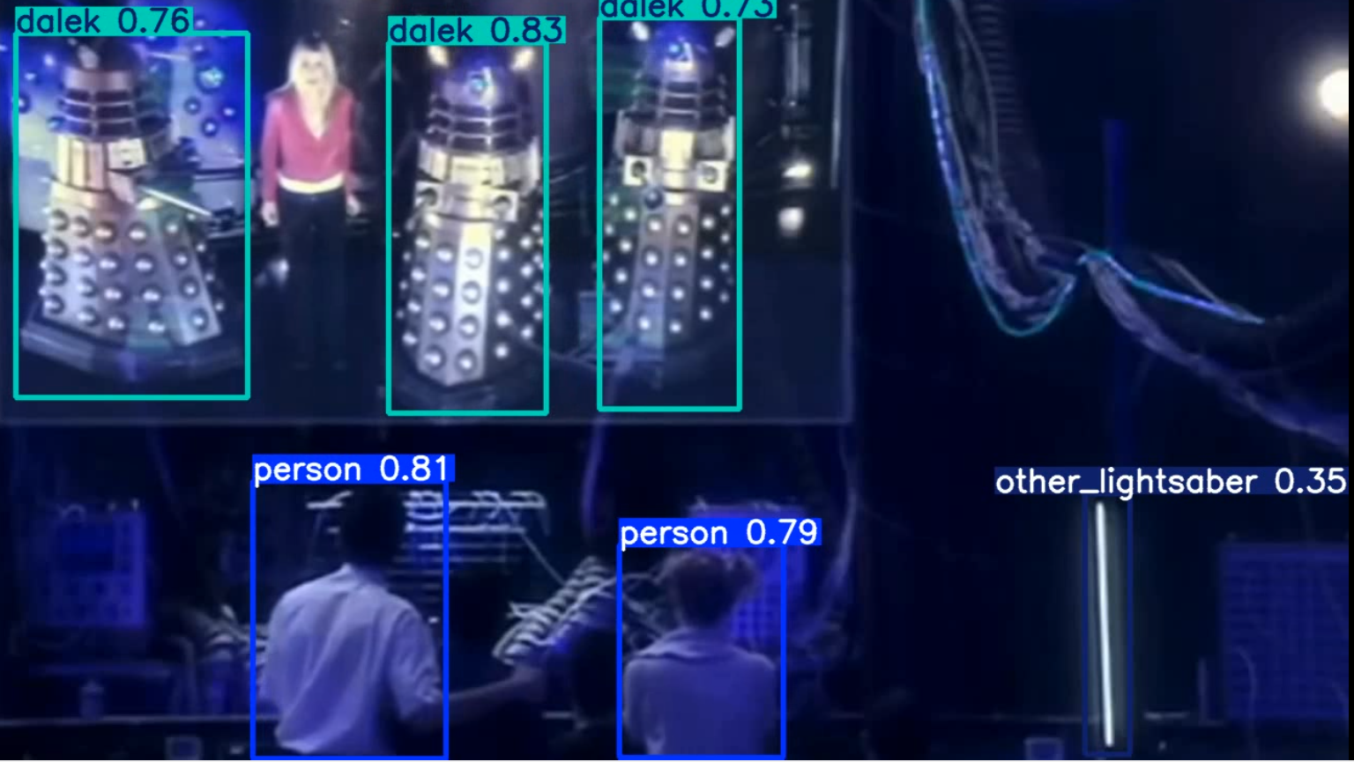
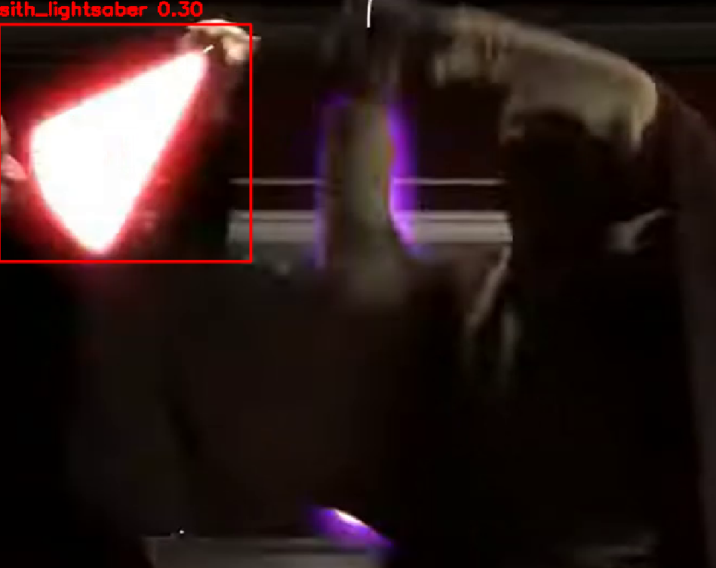
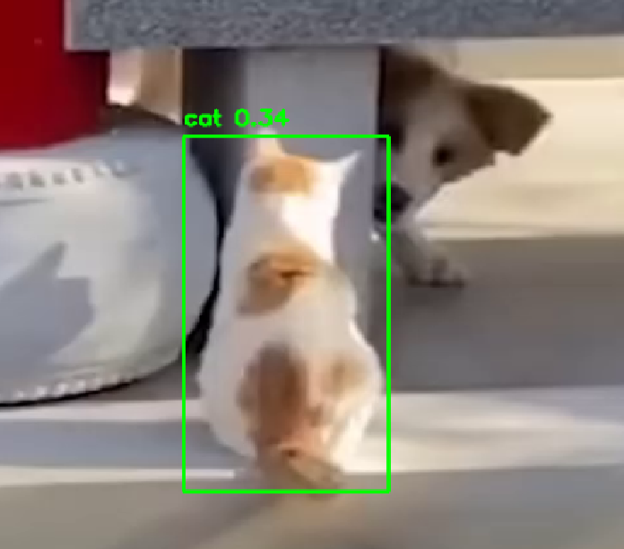
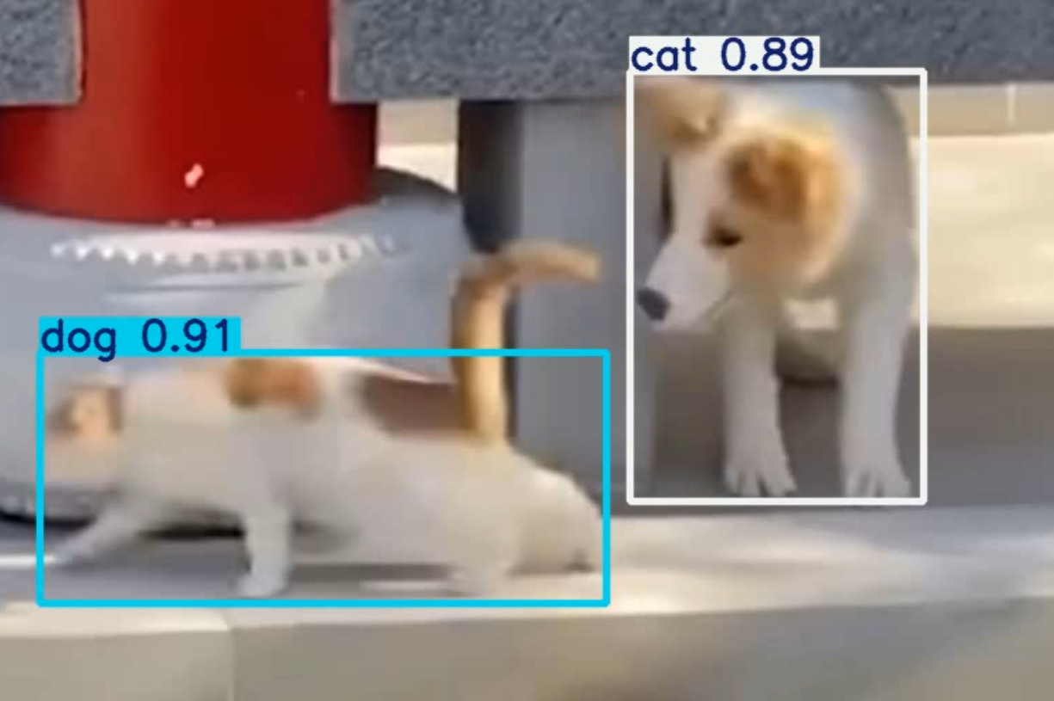
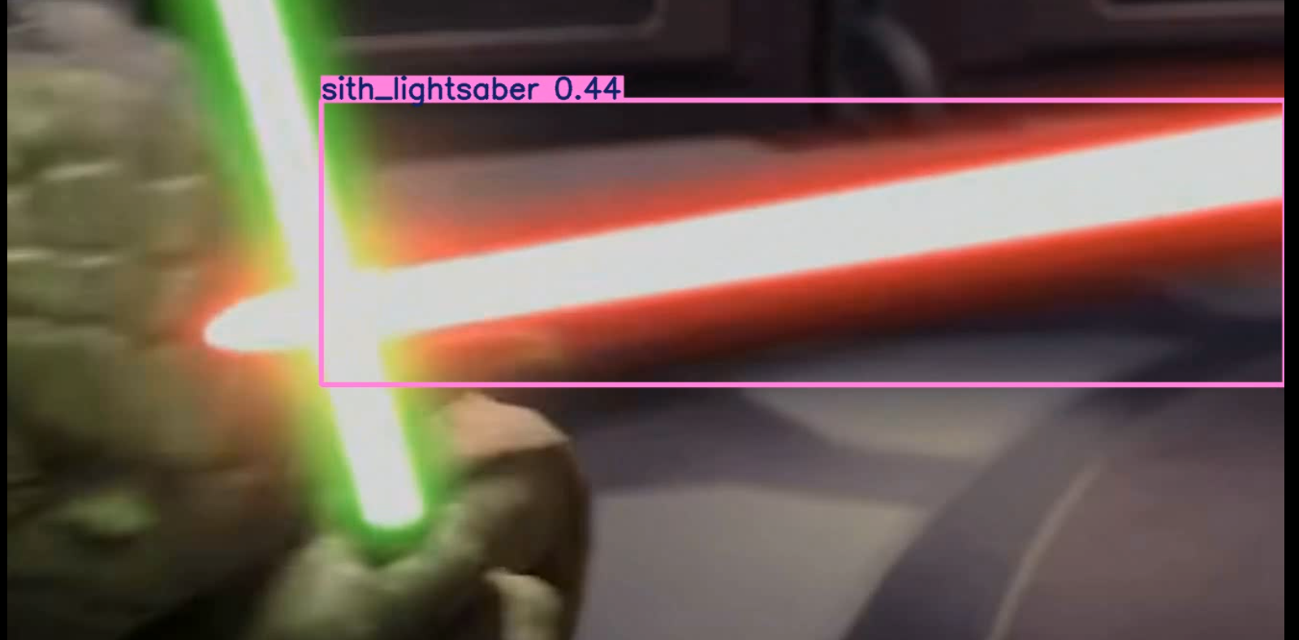
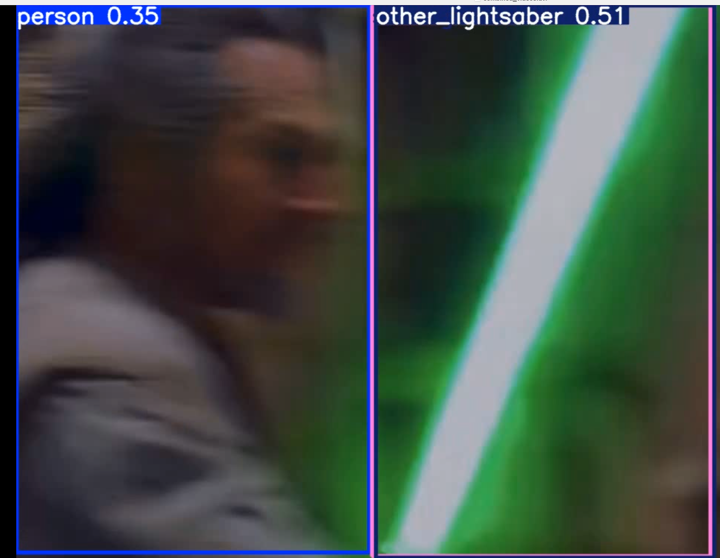
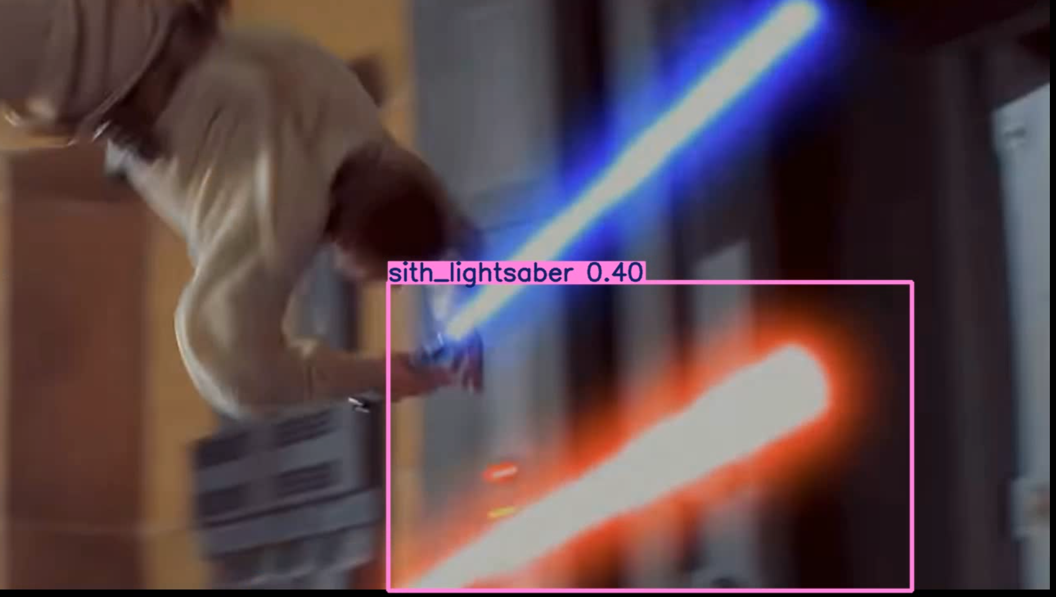
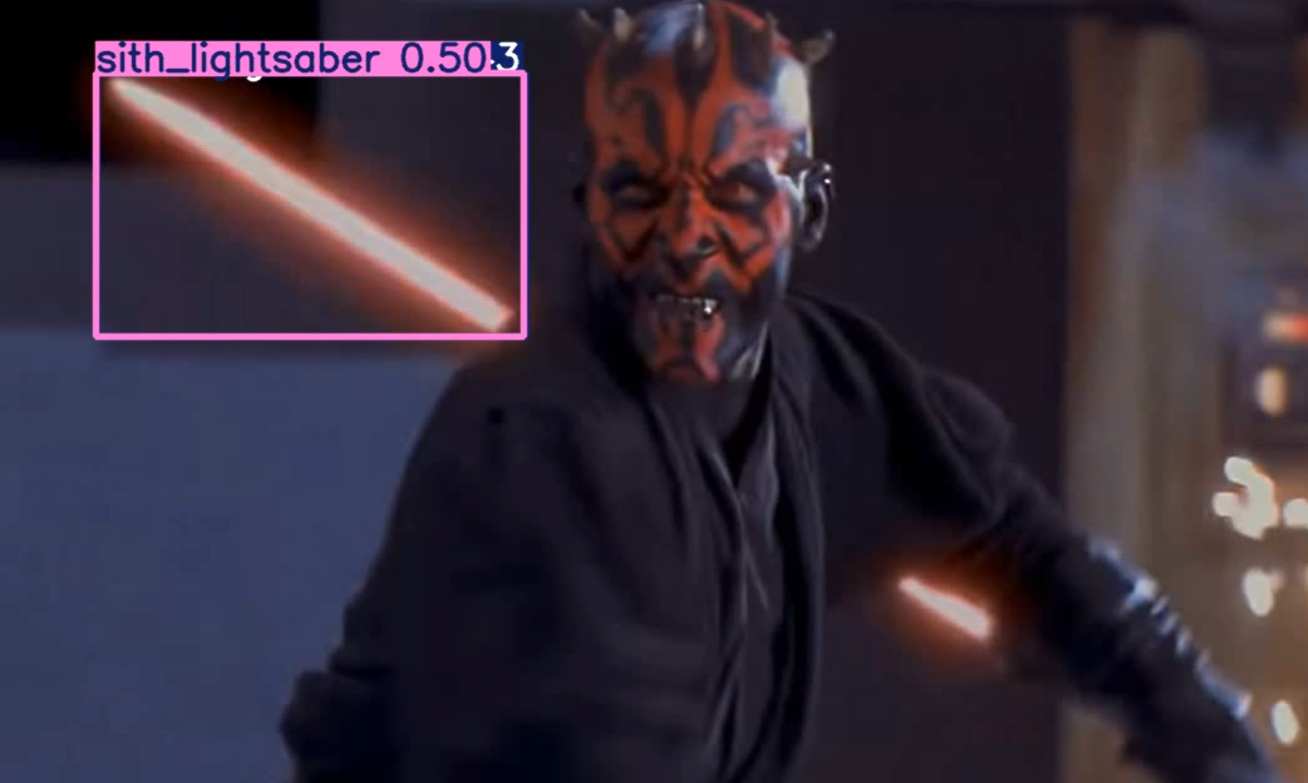
Screenshots

Slide 17
What Are FPN and PANet?
Used in YOLOv8 to handle multi-scale object detection:
FPN: Combines deep (semantic) and shallow (spatial) features.
→ Improves detection of small & large objects.
PANet: Adds bottom-up connections for richer feature flow.
→ Boosts localization and precision for all scales.

Slide 18
Questions?

Slide 19
YOLOv8 Loss Functions Explained
YOLOv8 uses multiple loss terms:
Box Loss: Measures bounding box alignment using CIoU.
Classification Loss: Penalizes incorrect class predictions.
DFL (Distribution Focal Loss): Predicts fine-grained box offsets.
→ Combined to improve accuracy and localization.

Slide 20
What is SGD?
Stochastic Gradient Descent (SGD):
Popular optimization method in deep learning.
Performs weight updates based on small data batches.
Faster and more memory-efficient than full-batch gradient descent.
YOLOv8 uses SGD with momentum to smooth updates.

